Slide 1

Data Analytics
by
G.Vishnu Priya
Roll No. 214G1A32C3
Department of Computer Science and Engineering (Data Science)
Srinivasa Ramanujan Institute of Technology
(Affiliated to JNTUA & Approved by AICTE) (Accredited by NAAC with ‘A’ Grade & Accredited by NBA (EEE, ECE & CSE)
Rotarypuram Village, B K Samudram Mandal, Ananthapuramu – 515701.
2023 - 2024

Slide 2

Contents
Course Objective
Introduction
Technology
Applications
Modules
Real Time applications
Learning outcomes
GitHub Link
Queries

Slide 3
Course Objective
To provide participants in the AWS data analytics virtual internship Cohort 5 with comprehensive knowledge and hands-on experience in utilizing AWS data analytics virtual Internship tools and techniques. Through interactive modules, real world case studies, and practical exercises, participants will gain knowledge in extracting insights from complex business processes, optimizing process efficiency, participants will have the skills to confidently apply data analytics virtual internship methodologies within various industries, enabling them to make informed decision that drive operational excellence and continuous process improvement

Slide 4
Introduction
Data Analytics:Data analytics is the process of analytics and interpreting data to gain insights and make informed decisions.
Data Analytics is the process of examining data sets to find trends and draw conclusions about the information they contain.
It involves using various techniques and tools to uncover patterns , trends , and relationships within the data.
It’s a valuable tool for businesses to optimize operations , improve decision-making , and drive growth.

Slide 5

Cont..
What is AWS ?
AWS (Amazon Web Services) offers a wide
range of real-time applications, such as
real-time analytics, real-time messaging,
real-time monitoring, and real-time collaboration
tools.
These applications can help businesses make
data-driven decisions, improve customer experiences,
and enhance operational eiffciency.

Slide 6
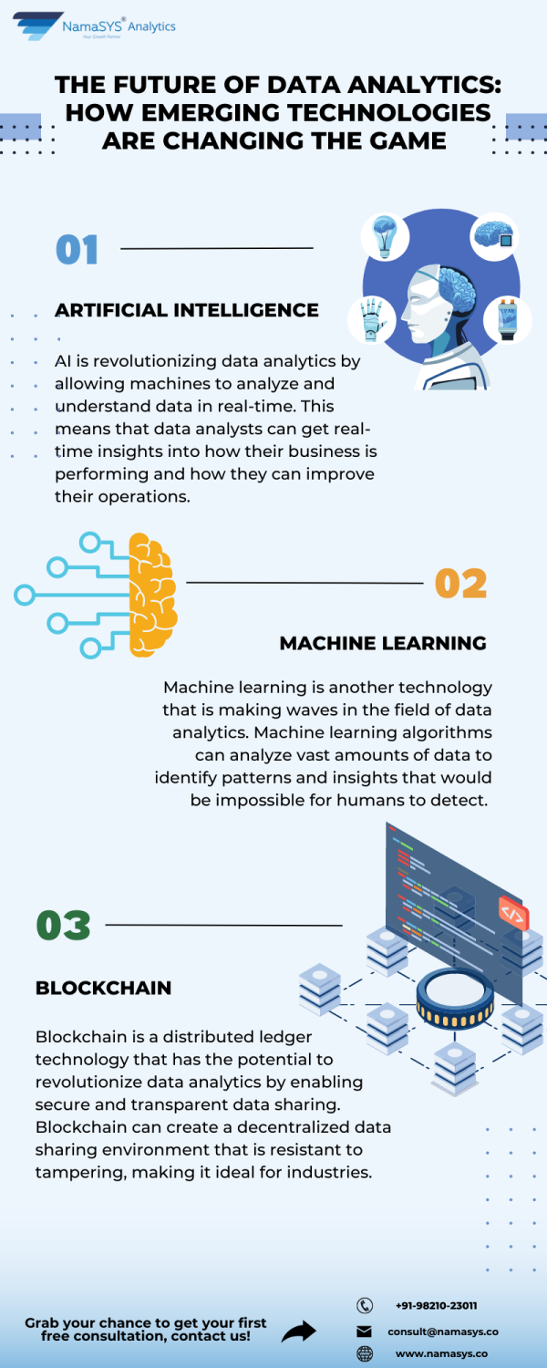
Techonology
The future of data analytics looks bright with emerging
technologies such as artificial intelligence, machine
learning, and blockchain. These technologies have
the potential to transform the way we analyze and
understand data, leading to new insights and discoveries
that were previously impossible.

Slide 7
Applications
Health Care Industry : Ongoing AI research is helping doctors in evaluating the outcome corrective jaw surgery as well as in assessing the cleft palate therapy to predict facial attractiveness.
Image Recognition : Image recognition in data analytics involves using advanced algorithms to analyze and interpret images , allowing for automated identification of objects , patterns or features within the images.
Business Intelligence : Analysing data to gain insights and make data-driven decisions for business growth.
Social Media Analytics : Analysing social media data to understand customer sentiments , trends and preferences.

Slide 8
Learning Outcomes
Data analytics can help an organization understand risks and take preventive measures for instance, a retail chain could run a propensity model – a statistical model that can predict future actions or events- to determine which stores are at the highest risk for theft.

Slide 9
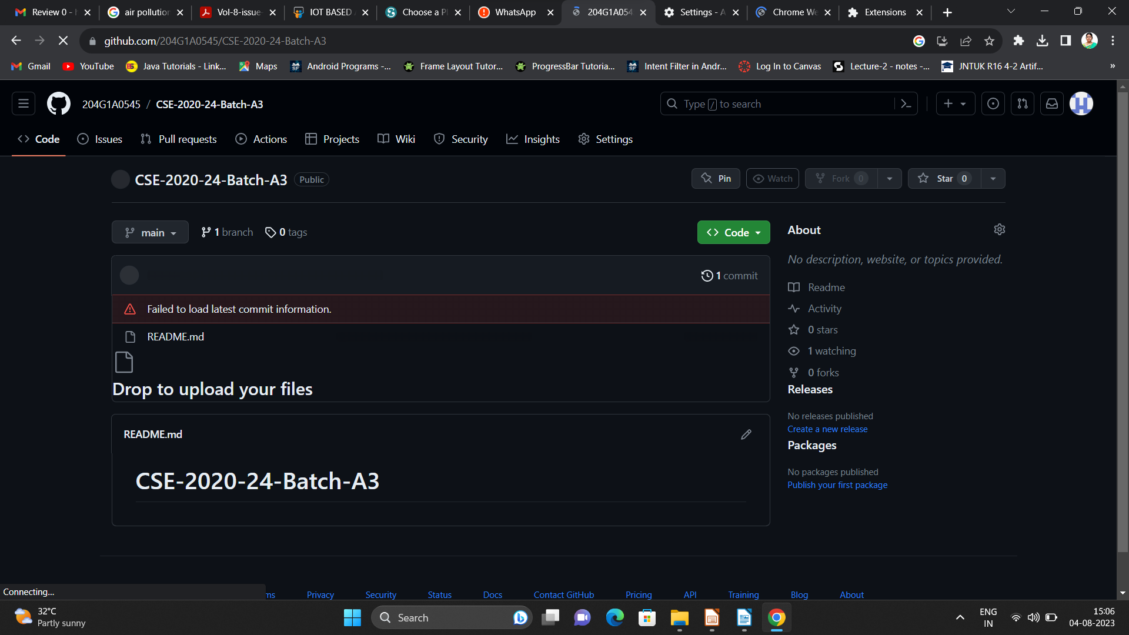

Git Hub Dashboard
Repository Name Like: Summer Internship - I
Under that include document, presentation and Certificate(Pdf).

Slide 10
Any Queries?

Slide 11
Thank You!!!

